Slide 1
Getting started!
Rotary Community Leaders
Prospective Candidate Briefings
March 2024
Jyoti, Rotarian since 2016.

Slide 2
Welcome
Purpose
The purpose is to brief prospective candidates on the Rotary Community Leader role
Welcome
and
purpose

Slide 3
Background
Why did we change to Rotary Community Groups (RCGs)?
How will they work?
What is the role of the Rotary Community Leader (RCL)?
What is the plan for learning, development and support?
Election process and timeline
Agenda

Slide 4
First, we need to go back a step:
Why did we change to Rotary Community Groups?
How will they work?
You may have other questions – there will be a chance to ask them
Background

Slide 5
Rotary in our Zone is in free fall
Why did we change to Rotary Community Groups (RCGs)?
Fewer clubs with fewer members – depleted in numbers and energy
Not all clubs! But EVERY District in our Zone is declining

Slide 6
Three core propositions:
Only clubs and members can make a difference to the outcomes that Rotary cares about
The current model no longer provides an effective support structure for clubs to thrive and grow (it really doesn’t)
Regionalisation 100% backs clubs to work together to create and live into their vision for the difference they want to make
Why did we change to Rotary Community Groups (RCGs)?

Slide 7
We are not going to be the generation that stands by!
We need an ‘energy boost’ and we need it fast
Where does that come from?
Why did we change to Rotary Community Groups (RCGs)?
RCG
Boosting numbers and energy through collaboration
Growing Rotary, RCG by RCG:
Increasing community impact
Raising Rotary’s profile
Attracting and engaging members
New clubs and satellite clubs

Slide 8
Each RCG creates its own growth plan/s (may be more than one)
Facilitated by a Rotary Community Leader
Clubs look at how they want and need to develop eg:
if the RCG is planning a major membership drive, how welcoming and attractive is each club?
if the RCG is planning a multi-club project, how engaged are club members?
How will they work?

Slide 9
Growth Plan
Reconsider club development in new context
Implement
Supported
RCG/Club-led
How will they work?
Facilitated

Slide 10
The RCG and the clubs in the group will have a lot of support
peer support within the group
support from the Rotary Community Leader
support from Rotary Specialists
tools, resources and initiatives from the Membership Portfolio Committee
public image materials and campaigns
high level partnerships
more efficient, technology enabled administration
How will they work?

Slide 11
You are their facilitator and partner in growth
You are their connector for the support they need (sometimes that will be you, sometimes not)
You are their coach
What is the role of the Rotary Community Leader (RCL)?

Slide 12
YOU don’t have to fix or change anything!
What is the role of the Rotary Community Leader (RCL)?

Slide 13
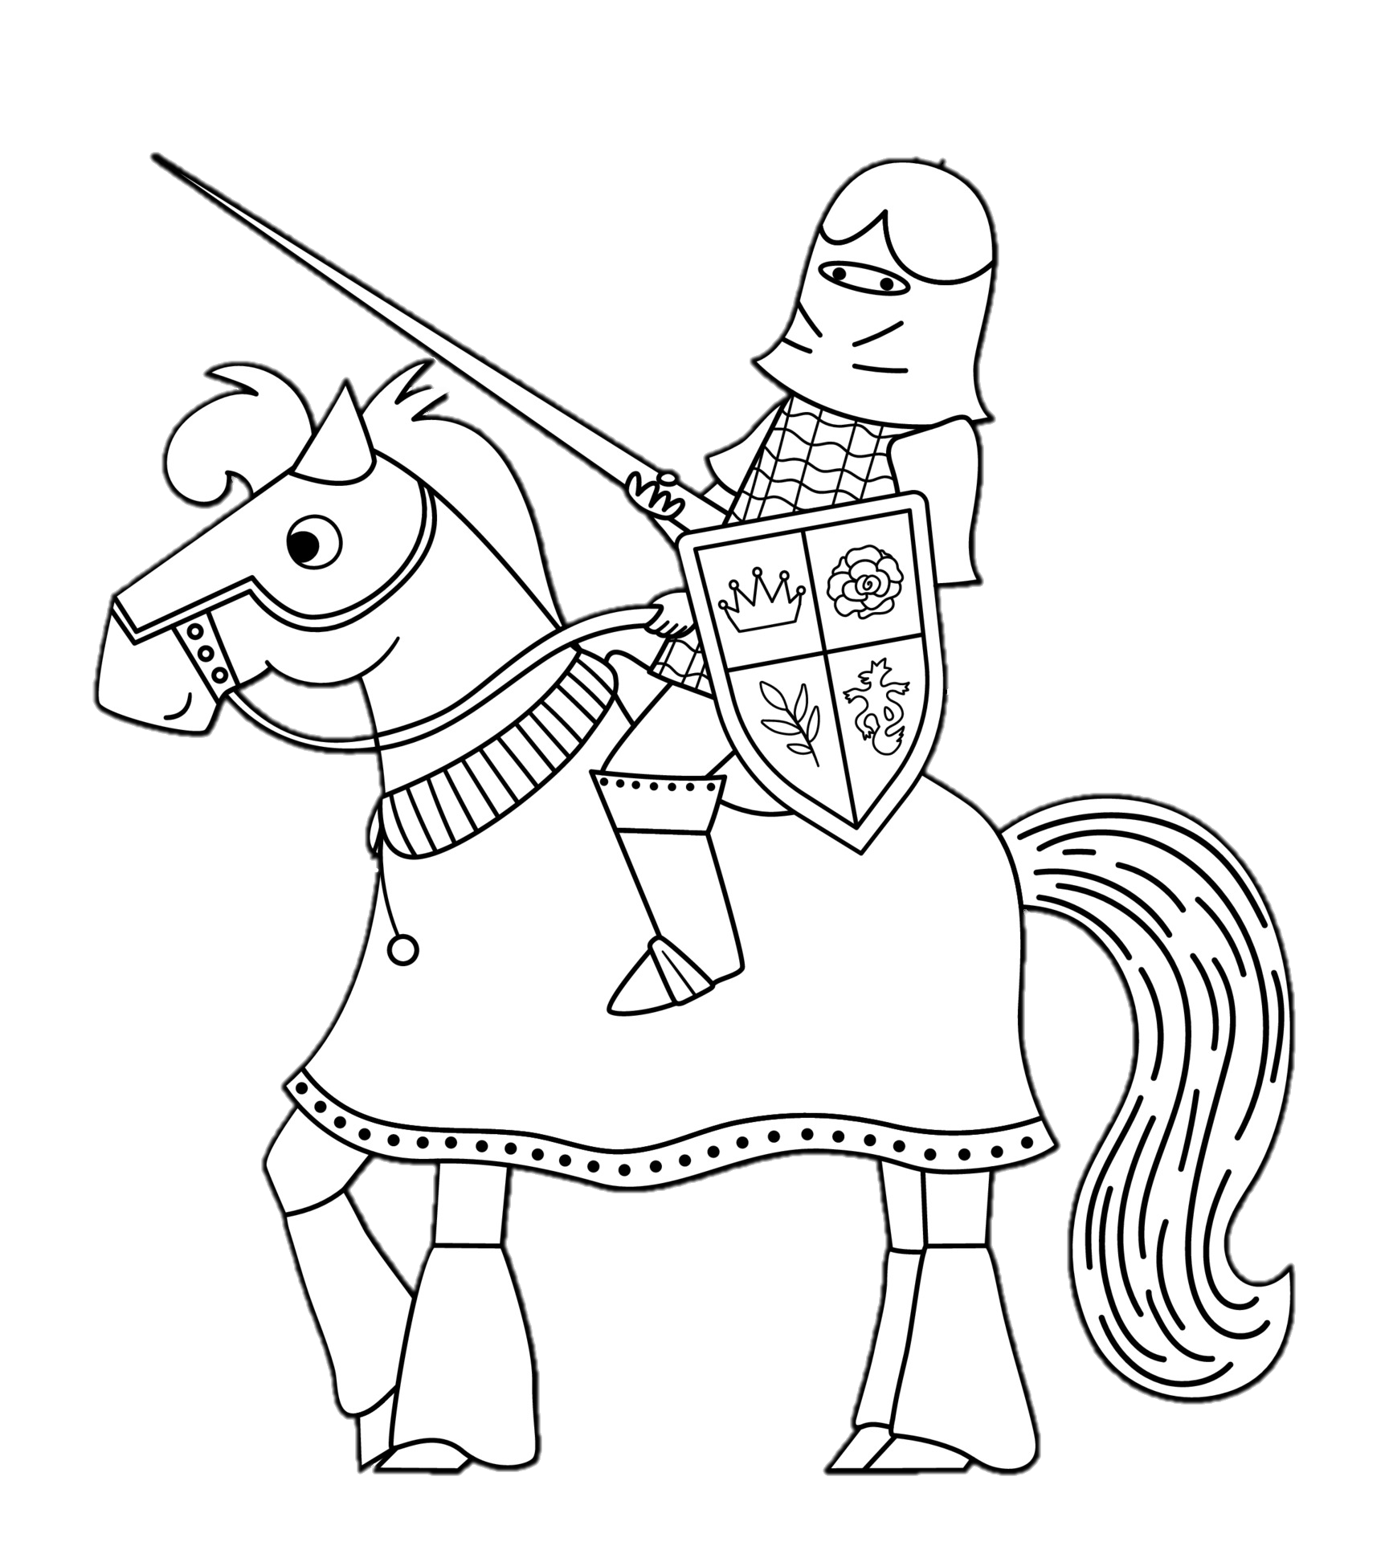
What is the role of the Rotary Community Leader (RCL)?

Slide 14
RCLs won’t schedule club visits
They will facilitate the leadership group of the RCG
These will be their closest relationships – building their capacity to lead and build relationships in their own clubs
Other engagements may be arranged – eg with all members of the RCG, members of a sub-group of clubs working on a development issue etc
What is the role of the Rotary Community Leader (RCL)?

Slide 15
RCLs won’t report to, or be directed by, District Governors – although this is a key relationship
RCLs won’t assess clubs or determine what they need or should do
Clubs will determine their own development needs through the RCG process
Other support needs met as required
Nothing in this process undermines the autonomy of clubs
What is the role of the Rotary Community Leader (RCL)?

Slide 16
Your role is to facilitate club leaders to:
create their RCG growth plan/s
look at their own club in light of what their club needs in order to contribute to, and benefit from, that growth plan
engage with their club members in the above
In that context:
coach and mentor your club leaders
ensure the RCG and its clubs obtain the support and expertise they need (whether directly from you, or from a Rotary Specialist or other source)
What is the role of the Rotary Community Leader (RCL)?

Slide 17
Q&A
What other questions do you have?

Slide 18
Overview
creating communities of support, learning and contribution
unleashing the potential of club leadership within your communities and in yourself
supported by the Rotary Communities Nominee, who will be elected by the RCLs, and represent them on the Regional Council
What is the plan for learning, development and support

Slide 19
Your Learning and Development journey
you will receive a letter as soon as you are elected stating details of your:
Self-Paced Learning
Induction Session (online)
Face to Face Workshops
How to book your travel
What is the plan for learning, development and support

Slide 20
What is the plan for learning, development and support
Self-Paced Learning (prior to induction)
Getting started with the Learning Centre
Collaboration

Slide 21
Induction Session (online)
What is the Pilot
Setup and structure
Where is it currently at
Where does the community leader role fit in
Discussion of opportunities and challenges you might see in the role with others
What is the plan for learning, development and support

Slide 22
Induction Session (online) – dates/times:
Group | Date | Time (in local time zone)
Melbourne 9780, 9790, 9800, 9815, 9830 | Mon 13 May | 7:30pm
Adelaide 9423, 9510, 9560 | Tues 14 May | 7:30pm
Auckland 9999, 9940, 9930, 9910, 9920 | Wed 15 May | 7:30pm
Sydney 9640, 9660, 9675, 9685, 9705 | Thurs 16 May | 7:30pm
What is the plan for learning, development and support

Slide 23
Self-Paced Learning (prior to face-to-face workshops)
Rotary Change Model
Building Consensus
Vibrant Clubs in Action
Rotary Action Plan
What is the plan for learning, development and support

Slide 24
Face-to-face workshops – held over a day and a half Saturday/Sunday – dates:
What is the plan for learning, development and support
Group | Date | Venue
Melbourne 9780, 9790, 9800, 9815, 9830 | 1-2 June | Mantra Tullamarine
Adelaide 9423, 9510, 9560 | 15-16 June | Ridges Airport
Auckland 9999, 9940, 9930, 9910, 9920 | 8-9 June | Jetpark Akl Airport
Sydney 9640, 9660, 9675, 9685, 9705 | 22-23 June | Stamford Plaza Airport

Slide 25
In the face-to-face workshops, you will learn/increase skills in:
Facilitating your RCG’s Growth Plan/s
Communication and Connections
Creativity and Growth
Collaboration
Preparing for your first Rotary Community Group meeting (workshop)
What is the plan for learning, development and support

Slide 26
Each RCG will follow the same simple process…
…but will produce a unique Growth Plan
What is the plan for learning, development and support
Six-step process to develop a RCG Growth Plan:
1. Getting started
2. Discovery
3. Agreeing the focus
4. Action planning
5. Setting success measures
6. Finalising the Growth Plan

Slide 27
Q&A
What other questions do you have?

Slide 28
Mid Feb – mid March
Establishment Meetings held to prepare information packages for potential candidates for RCL role
Mid Feb – 22 March
Expressions of Interest open (opening date advised by District) for potential candidates for RCL role
1
2
2 April, 5pm AEDT
Expressions of Interest close Zone-wide
8 April
Ballots sent to clubs for elections in RCGs with more than one nomination – 1 vote per club, preferential
3
4
Election process and timeline
5
25 April, 5pm AEDT
Elections close
6
29 April
Provisional results
7
29 April – 9 May
Objection period
8
10 May
Confirmed RCLs announced

Slide 29
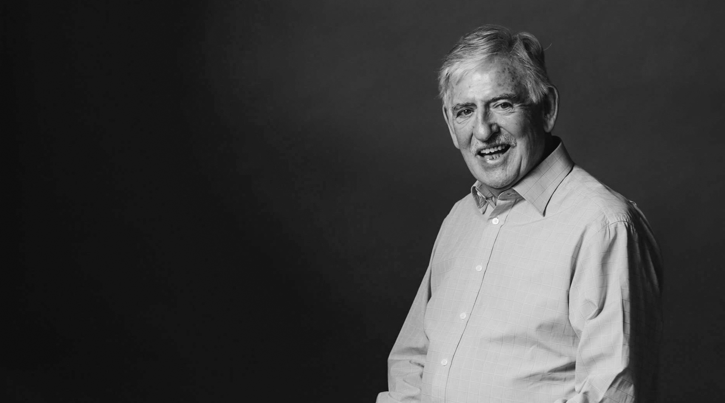
Learn more
CreatingTomorrowRotary.org
RotaryRegionalPilot@gmail.com
Follow the Pilot on Facebook

