Slide 1


  Zone 8
  Regionalisation
  Pilot
Update for clubs and members,
October 2023
  Jyoti, Rotarian since 2016.

Slide 2
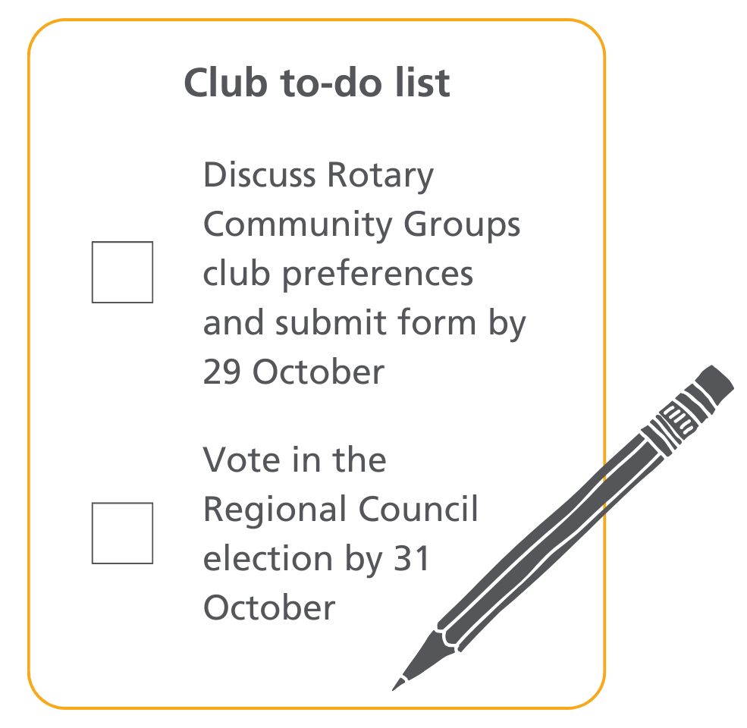
  Updates
      Rotary International Board has approved the formation of the Regional Council as a legal entity
      Governors-Elect have agreed to:
        First batch of functions being transferred from Districts to the Pilot operating model
        Staged approach to transfer of additional functions
      Scope and detail of transfers is currently being worked out

Slide 3
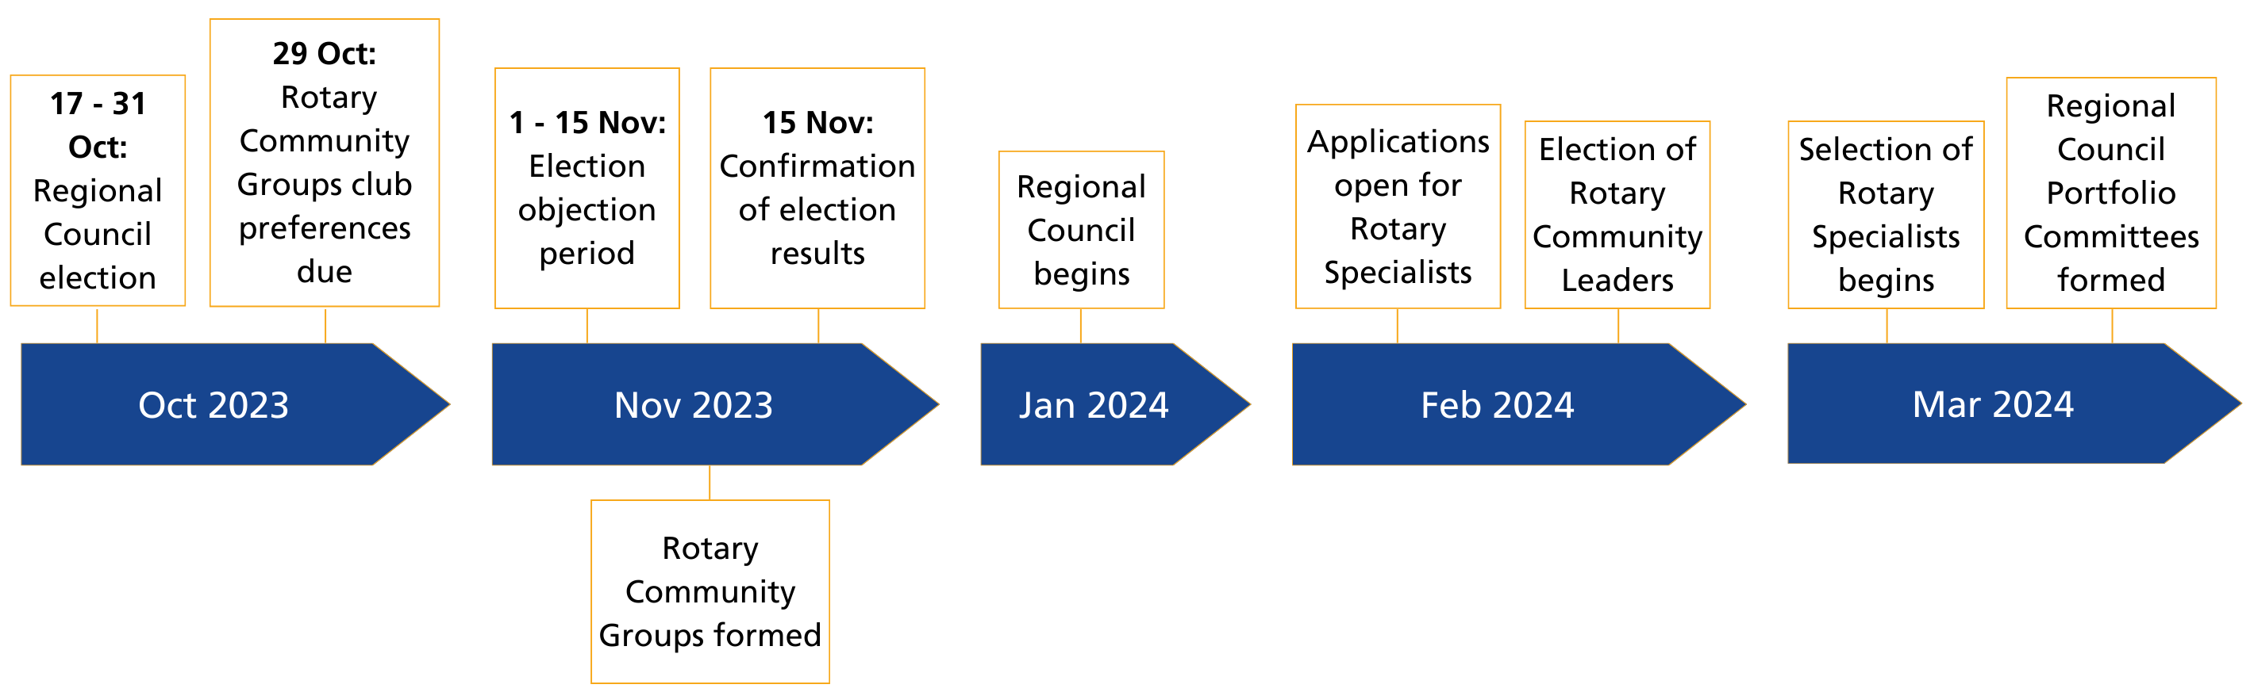
  Upcoming milestones

Slide 4
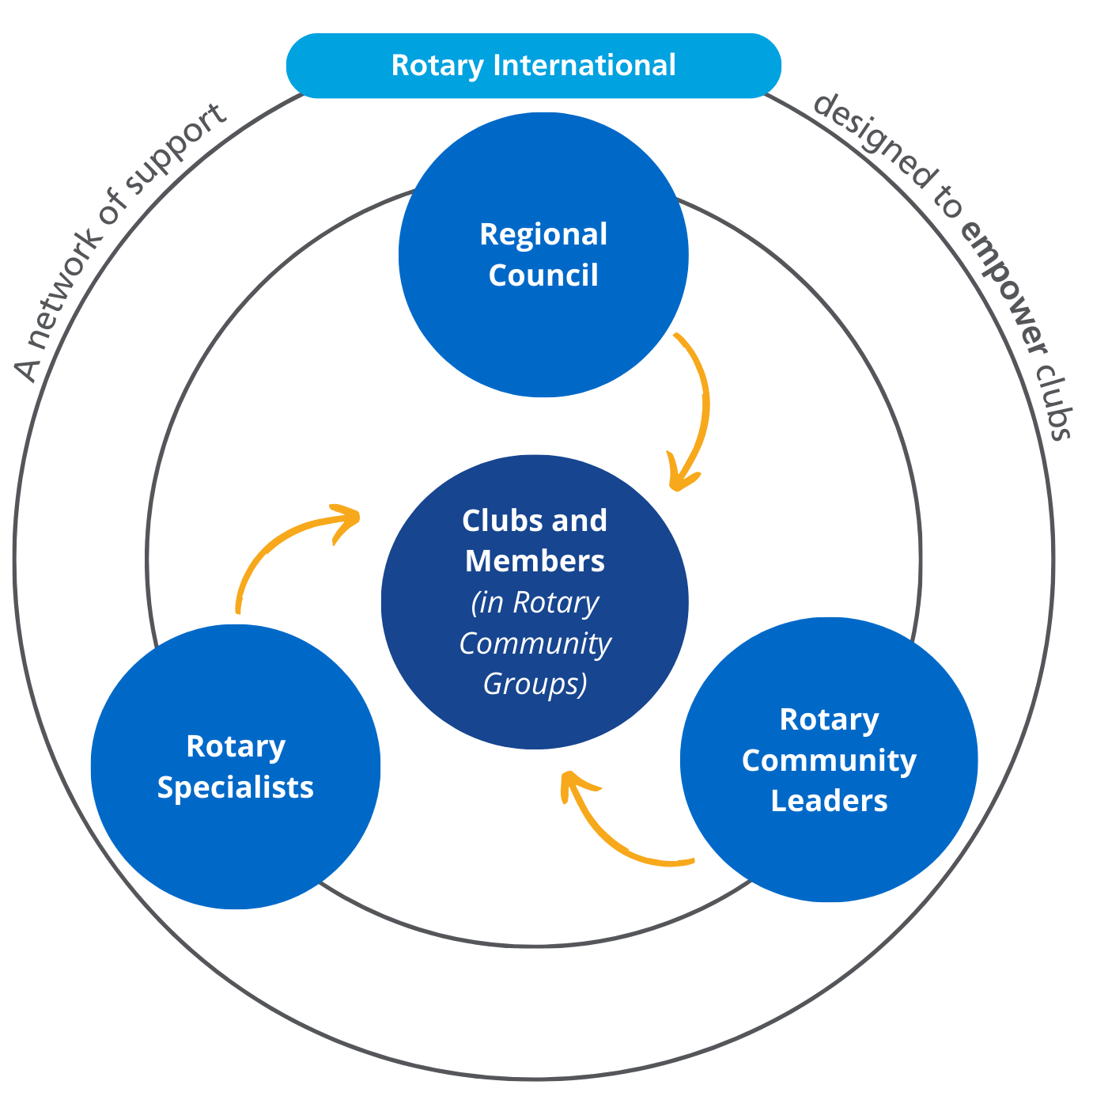
  Pilot
  Operating
  Model

Slide 5
  Regional Council
Rotary International (and The Rotary Foundation)
*Portfolios:
Service Projects and Programs
Public Image and Partnerships
Membership
Learning and Development
Fundraising and Grants
Diversity, Equity and Inclusion
Regional Council Chair
Chair-Elect
Portfolio Leads*
Rotaract Nominee
Rotary Communities Nominee
Corporate and Admin (non-elected)
Multi-national Advisory Committee
Functional Committees (Legal Entities, Financial Assets, Insurance, etc.)
Rotary Community Leaders
Portfolio Committees*
Rotary Specialist Network
Liaison for Incorporated Entities
Country Representatives
District Governors
RI Office (Sydney)
Zone Strategic Planning
Club leaders and members requiring support go to…

Slide 6
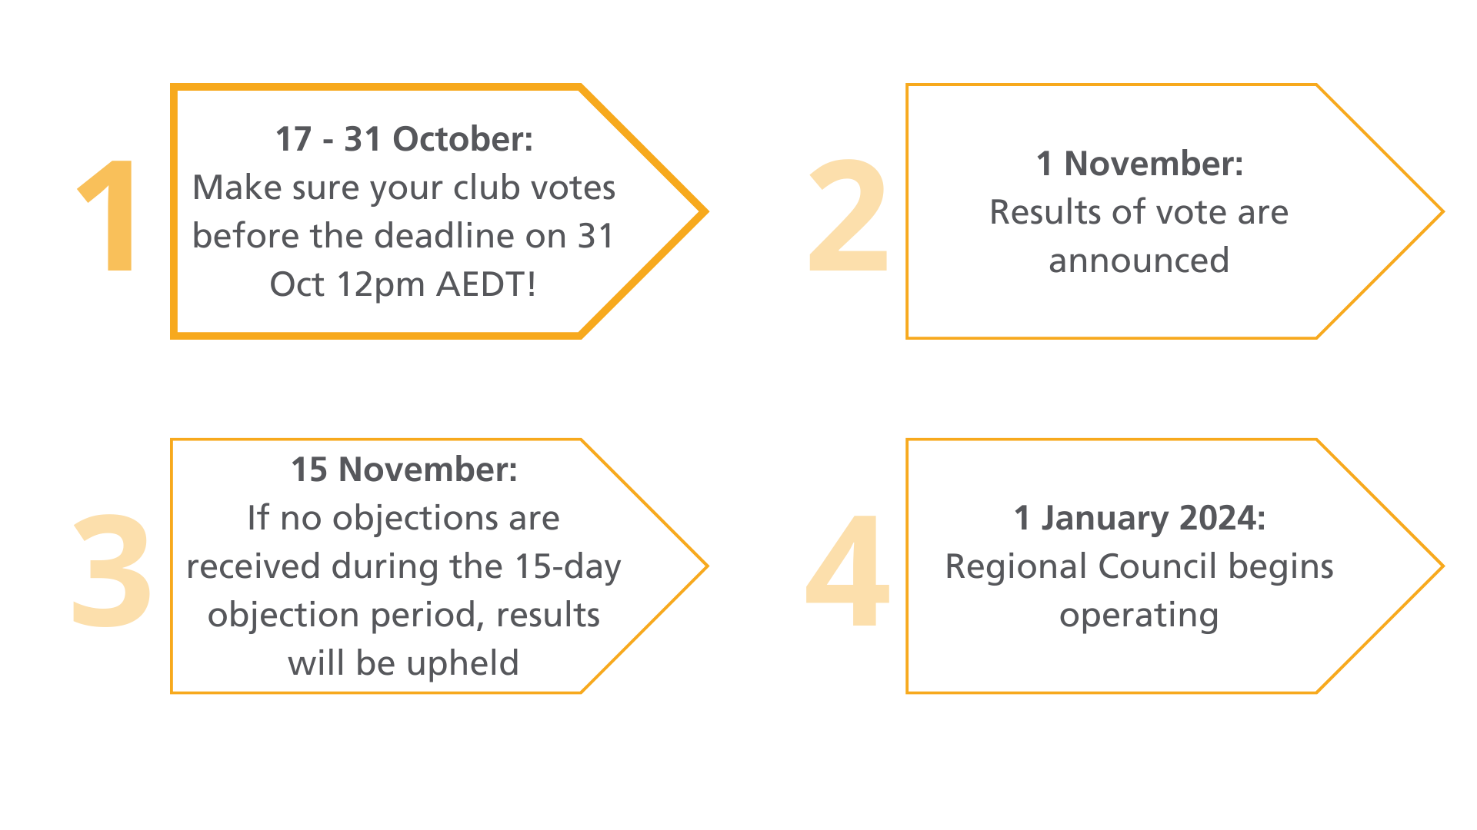
  It’s time to vote!
Today
109 days
100%
20 days
100%
699 days
0%
92 days
0%
365 days
0%
426 days
0%
120 days
0%
365 days
0%
122 days
0%
91 days
0%
912 days
0%
912 days
0%
212 days
0%

Slide 7
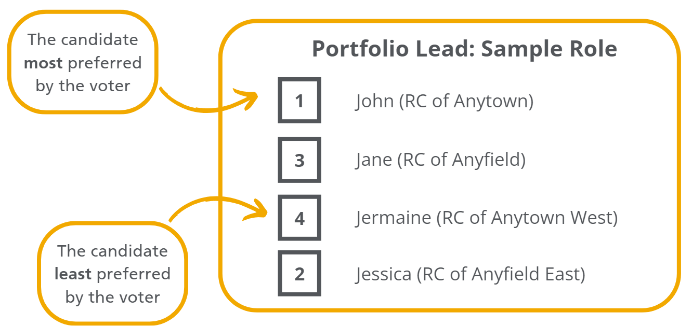
  How to vote
Today
109 days
100%
20 days
100%
      Club Presidents will vote electronically on behalf of their club, and must submit a vote for all Regional Council roles listed on the ballot
      If you are a Club President and have not received the link to vote, email Zone8Elections@rotary.org for assistance
      Each club can only vote once
      Voting is preferential
699 days
0%
92 days
0%
365 days
0%
426 days
0%
120 days
0%
365 days
0%
122 days
0%
91 days
0%
912 days
0%
912 days
0%
212 days
0%

Slide 8
  Resources to help you
Today
109 days
100%
20 days
100%
699 days
      Available on the Creating Tomorrow website:
      The list of candidates up for election
      A short how to vote guide for Club Presidents
      An explanation of the preferential voting system being used
0%
92 days
0%
365 days
0%
426 days
0%
120 days
0%
365 days
0%
122 days
0%
91 days
0%
912 days
0%
912 days
0%
212 days
0%

Slide 9
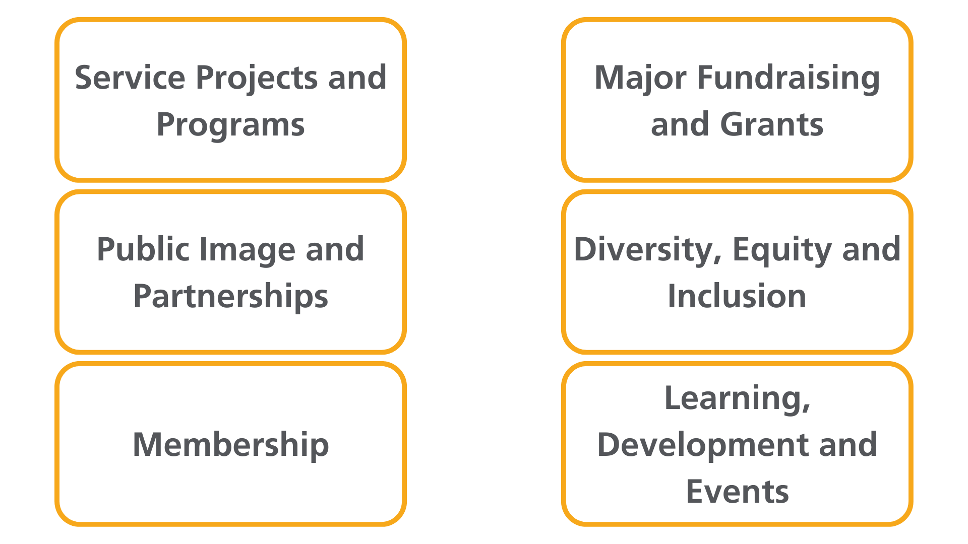
  Portfolio Committees

Slide 10
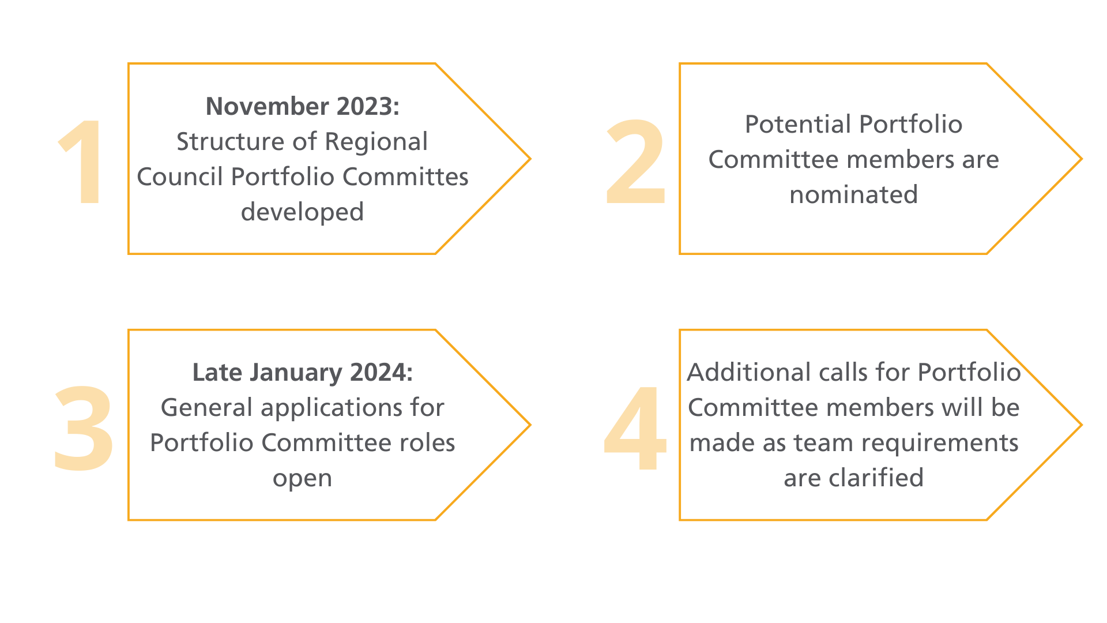
  Portfolio Committees

Slide 11

  What are Rotary Community Groups (RCGs)?
      A new way of grouping clubs based on commonalities such as:
Geography
Type of club
Common feature
      Can meet in person, online or a combination of both, and will choose how often they meet
      Clubs can also nominate a secondary grouping that will operate in online networks across the Zone

Slide 12
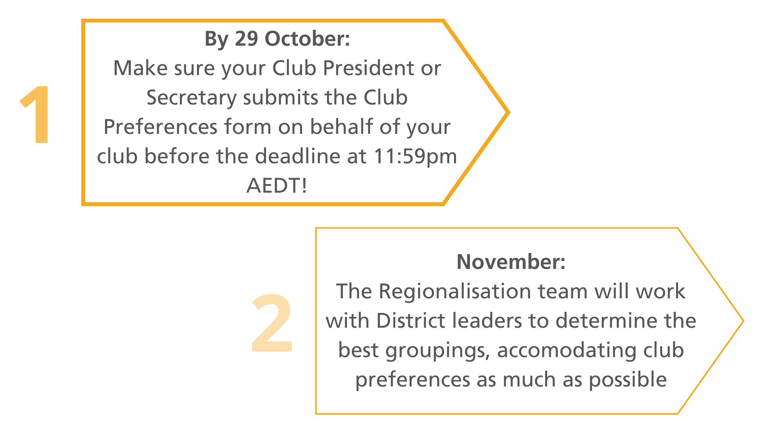
  Submit your RCG Club Preferences Form
Remember…
Discuss the form as a club
The responses in the form need to reflect the majority view of club members
Haven’t received the link to complete the form?
Email Michelle.Gallace@Rotary.org for assistance

Slide 13
  Resources to help you
      Available on the Creating Tomorrow website:
      A short video outlining what RCGs are and how to submit your Club Preferences form
      A presentation on RCGs and accompanying speaking notes
      A sample of the full Club Preferences form in PDF format for you to review with your club before submitting the electronic form

Slide 14
  What is a Rotary Specialist?
Individuals or teams of people who are experts in a particular field and will:
Give advice and/or support to clubs
Know who other experts are
Liaise with clubs remotely or in person
They can be:
People who have been in Rotary for a few months or a few decades
People who have never held a position outside of their club before
Rotaractors
Current or former Assistant/Area Governors
Current or previous District leaders
Position description and selection criteria now available on Creating Tomorrow website
Applications open:
February 2024

Slide 15






  Examples of Rotary Specialists
Helping clubs resolve conflict is my superpower!
I’m a club compliance nerd!
I’m an experienced event manager.
Due to my experience as a District Membership Chair, I’m an expert in helping clubs recruit new members.
I have a marketing background and want to help clubs with their public image.
I help organise RYLA in my District and love helping clubs get involved for the first time.

Slide 16
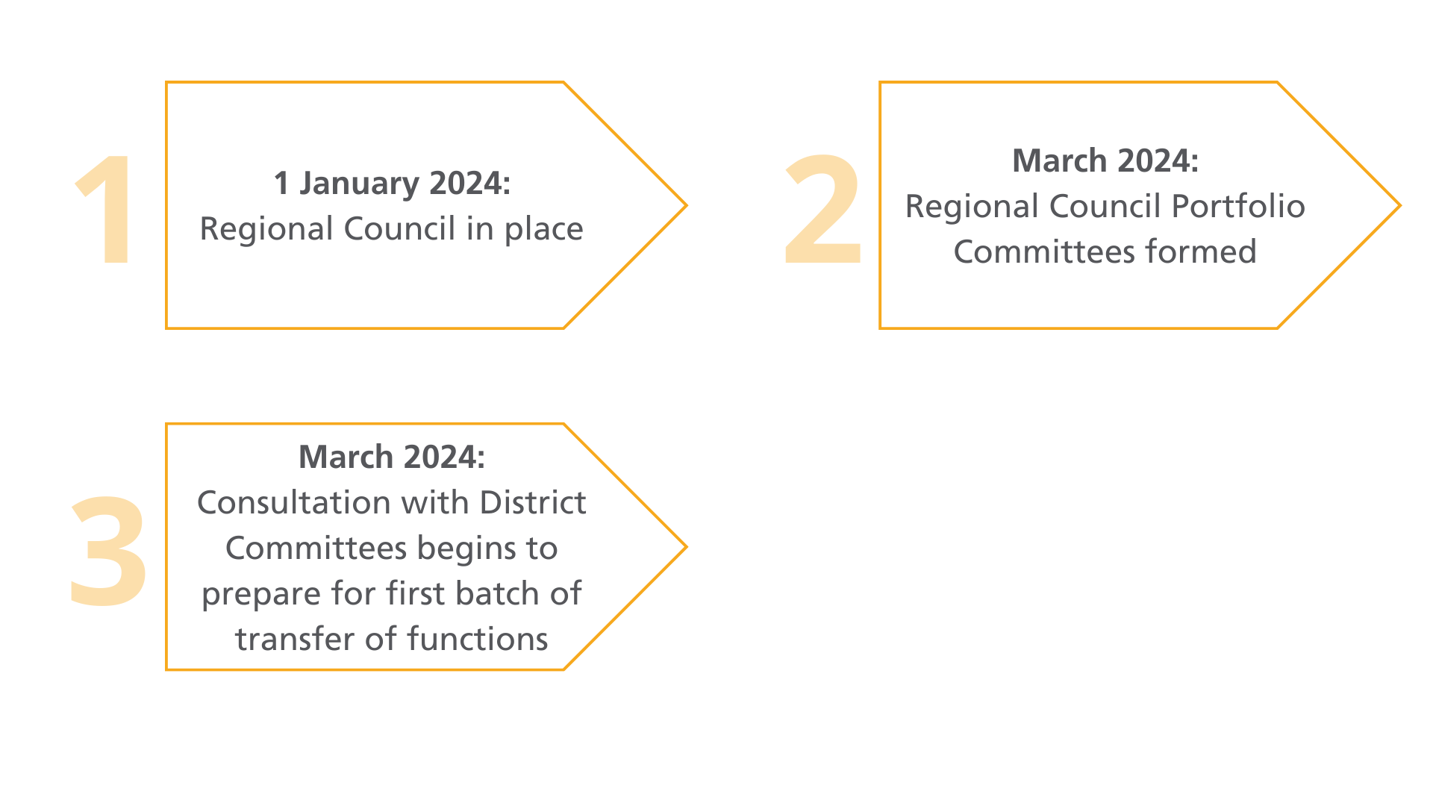
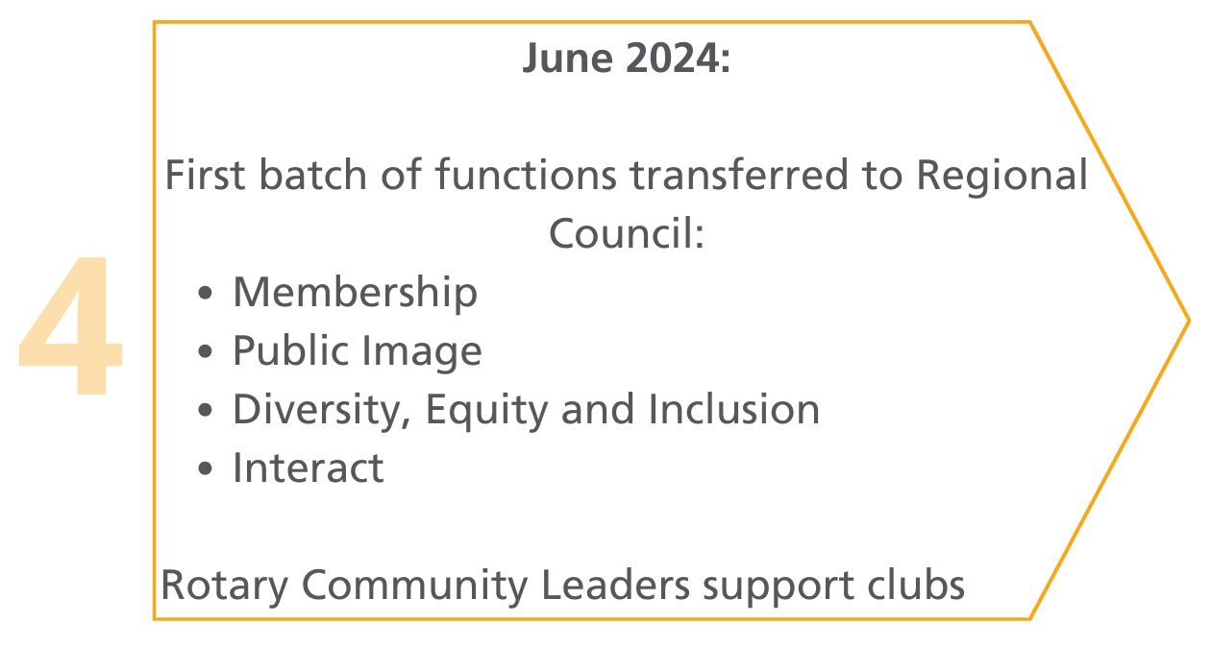
  Transformation of District functions
Today
109 days
100%
20 days
100%
699 days
0%
92 days
0%
365 days
0%
426 days
0%
120 days
0%
365 days
0%
122 days
0%
91 days
0%
912 days
0%
912 days
0%
212 days
0%

Slide 17
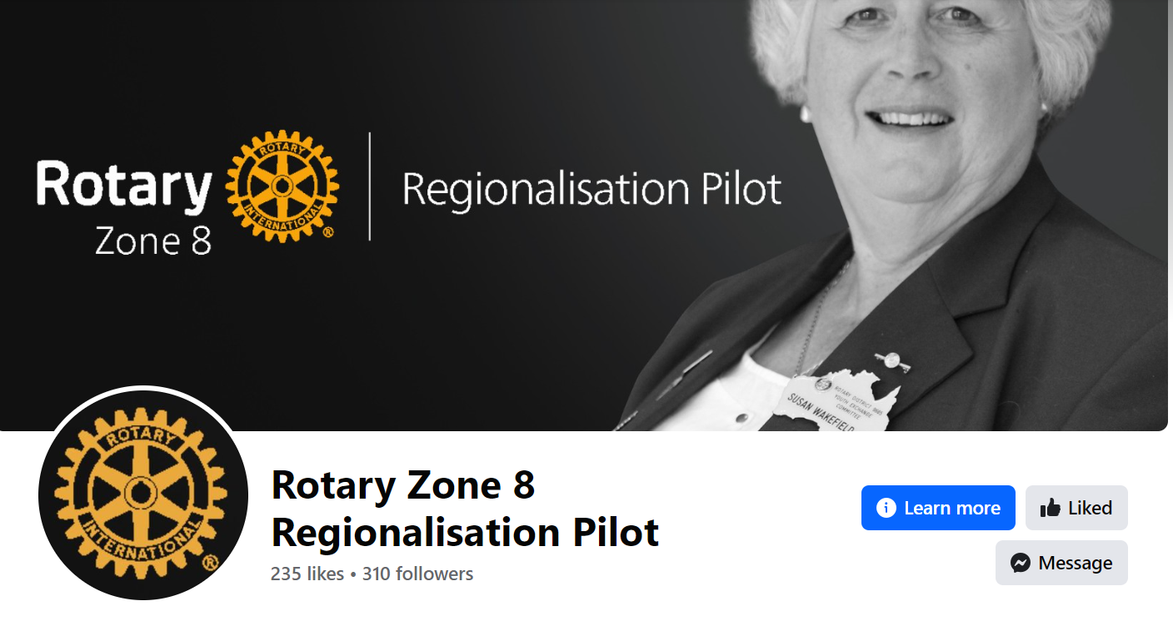
  For more information
      Visit CreatingTomorrowRotary.org and follow our new Facebook page.

