Slide 1


  Zone 8
  Regionalisation
  Pilot
Update for clubs and members,
August 2023
  Jyoti, Rotarian since 2016.
Notes:
Introduction with country specific welcome
Introduction of presenter(s)
The purpose of this presentation is to provide a summary of the key changes that are being implemented to support and progress the Zone 8 Regionalisation Pilot.
The Pilot is one of only two Rotary International approved pilots in the world, the other being in Rotary Great Britain and Ireland.

Slide 2

  From (now):
  To (opportunity):
  Small local projects connecting
  through personal contacts for local impact.
  Collaboration
  Multi district collaboration. Large scale projects.
  Large scale noticeable and measurable impact.
  National and regional partnerships.
  Local and/or internal audience with limited reach.
  So, people don’t know who we are, what we do.
  One voice
  External audience. Large scale campaigns.
  National media. Wide reach.
  Partnerships.
  Local support that’s geographically based.
  Specialist expertise is difficult
  to access and not readily visible.
  Club support
  Clubs at the heart. Elected, motivating leadership.
  Connect clubs through affinity and commonality.
  Support for new membership models.
  Access to specialist support and partners.
  Duplication of processes.
  Multiple and independent communications
  making information difficult to find.
  Efficiency and technology
  Automation of common processes.
  Common technology and better use.
  Ready access to information.
  Support for small clubs. Reduced costs.
  Traditional ways of operating.
  Too dependent on individuals.
  Annual turnover of leaders.
  Innovation and adaptation
  More support for new ideas.
  More leadership than management/administration.
  Adapt to new trends of volunteering.
  Longer term planning and roles.
Notes:
The pilot is about trialing a new Governance model in Zone 8, supported by a new operating model. The new operating model will provide a platform for:
Developing and delivering on multi-year strategies to enhance Rotary’s profile and footprint across Zone 8
Harnessing the best practices that are identified by clubs and members and sharing these consistently across the zone to strengthen our operations and outcomes
Reducing time spent on administration processes across the zone by removing duplication and introducing automation of common processes.
Empowering clubs and their chosen community of clubs to develop local goals and to enable more collaboration to achieve these.
Identifying members who have recognised skills and experience, to act as Rotary Specialists to support clubs across the Zone.
This is a big vision, so how are we getting started?

Slide 3
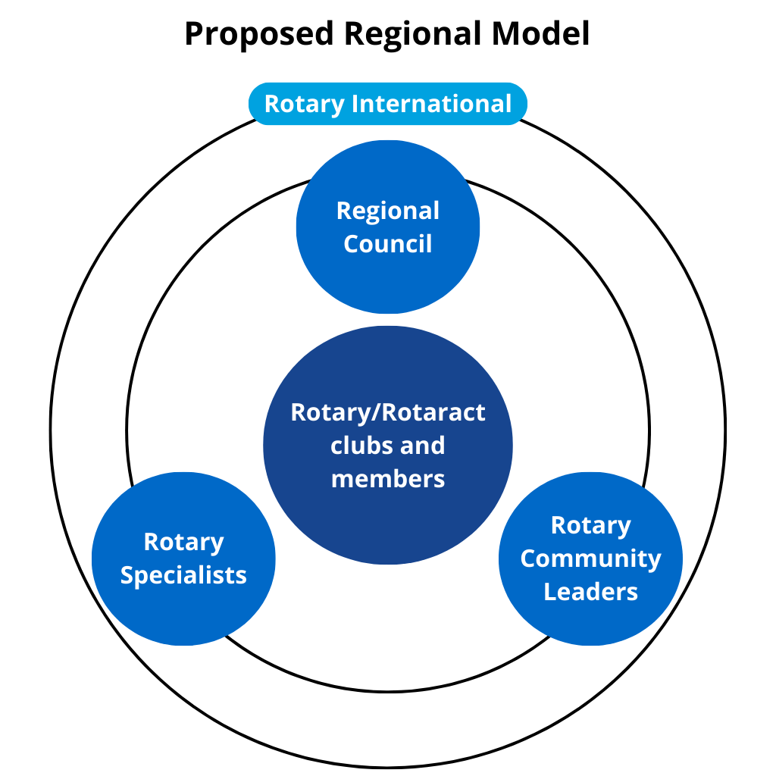
  Pilot operating model
Notes:
The Pilot is introducing a new operating model which features three new groups of volunteer roles who will work to support Rotary and Rotaract clubs and members to maximise their goals and outcomes.
•First is the Regional Council, which will be the leadership body for Zone 8 and will be responsible for setting strategies, goals to align with Rotary’s Action Plan and the goals defined in the Pilot proposal.
•The second is Rotary Community Leaders, who will facilitate collaboration between groups of clubs and connect clubs and members to specialists and support resources as required.
•The third are Rotary Specialists, a very important role where volunteers provide their skills, knowledge and experience to Clubs, groups of Clubs and members.
In this presentation, we’re now going to focus on the Regional Council and Community Groups and Rotary Community Leaders.
More info on Rotary specialists will be provided in the near future.

Slide 4
  Regional Council structure
Rotary International (and The Rotary Foundation)
Regional Council Chair
Chair-Elect
Portfolio Leads*
Rotaract Nominee
Rotary Communities Nominee
Corporate and Admin (non-elected)
Multi-national Advisory Committee
Functional Committees (Legal Entities, Financial Assets, Insurance, etc.)
Rotary Community Leaders
Portfolio Committees
Rotary Specialist Network
Liaison for Incorporated Entities
Country Representatives
District Governors
RI Office (Sydney)
Zone Strategic Planning
*Portfolios:
Service Projects and Programs
Public Image and Partnerships
Membership
Learning and Development
Fundraising and Grants
Diversity, Equity and Inclusion
Notes:
Expressions of Interest are currently open for the following Regional Council roles.
All roles have a two year term, except the Rotaract Nominee and Rotary Community Leader Nominee.
The Regional Council Chair will be responsible for leading and managing the Regional Council. This includes ensuring the Council focuses on its agreed mission, vision, and strategies without preference to geography or interest.
The Regional Council Chair Elect, while preparing for their future role as Chair, will be responsible for developing, communicating, and managing the Zone Strategic Plan and ensuring the voices of all countries and regions are heard. To ensure there is strong representation from all Island nations, it is proposed that the Chair Elect will lead a Multi-National Advisory Committee in which members will represent the perspectives of their countries. The Chair-elect will also liaise with existing Rotary entities, like RDU, RAWCS etc
There are six Portfolio Lead roles who are accountable for outcomes in their respective portfolio area:
Service Projects and Programs
Public Image and Partnerships
Membership (Growth, retention and new club creation)
Learning and Development
Fundraising and Grants
Diversity, Equity and Inclusion
The Rotaract Nominee will be tasked with ensuring Rotaract perspectives are considered as the Regional Council develops new programs and initiatives to increase the reach and success of Rotaract and Rotary across the Zone.
This is an excellent opportunity for experienced Rotaract members to put themselves forward for election to contribute to Rotary administration at a regional level and explore the future of Rotaract in Zone 8.
Only active Rotaract members are eligible to apply for this position which is a minimum 1 year term. Rotaractors are also able to apply for all other positions on the Regional Council.
The Rotary Community Leader Nominee election will be conducted in 2024, after Rotary Community Leaders have been selected.
The Corporate and Administration role is a non-voting position on the Regional Council and the role description is currently being finalised and will be shared in due course.
All roles are volunteer roles and not paid. Some expenses will be reimbursed.
It is important to note that the existing Districts will remain in place during the pilot. Some responsibilities will be transitioned from Districts to the Regional Council , Rotary Community Leaders and Rotary Specialists during the course of the pilot.

Slide 5
  Regional Council election timeline
Today
109 days
100%
20 days
100%
18 Aug – 4 Sept:
Expressions of Interest for Regional Council positions open
17 – 31 Oct:
Clubs vote electronically via link sent through email
1 – 15 Nov:
If no objections are received, results will be upheld
699 days
0%
92 days
0%
365 days
0%
426 days
0%
Voting
Results
Objection Period
Regional Council
EOIs
Candidates Apply
120 days
0%
365 days
0%
122 days
0%
91 days
5 Sept – 19 Sept:
Eligible candidates for Regional Council positions receive and submit application form
0%
1 Nov:
Results of vote are announced
Jan 2024:
Regional Council commences
912 days
0%
912 days
0%
212 days
0%
Notes:
Any Rotary or Rotaract members who are interested to apply for roles on the Regional Council need to lodge their online Expression of Interest by 4 September 2023 12pm AEST.
An email will generate to their nominated club officer for certification that the member is in good standing.
On 5 September, all eligible applicants will receive an application pack for their completion.
A small panel will review applications, to confirm that applicants meet the criteria.
The Panel will then announce the candidates for the election.
Club Presidents will receive electronic ballot forms on 17th October to input the ballot on behalf of their club.
Election results are expected to be announced on 1 Nov.
There will be a 15 day objection period.
Full details of the Election process is available on the process are available on the creatingtomorrowrotary.org website.
If you’re interested in shaping the future of Zone 8 through a new leadership role in the Regional Council, submit your EOI now!

Slide 6
  Rotary Community Groups (RCGs) and Leaders (RCLs)
      A new way of grouping clubs based on commonalities such as:
            Geography e.g. a large area of spread-out clubs, a smaller area of close clubs
            Type of club e.g. e-Clubs
            Shared language e.g. French-speaking clubs
      RCGs can meet in person, online or a combination of both, and choose how often they meet
      Clubs can also nominate a secondary grouping that will operate through online networks across the Zone
            Potential groupings include environment, youth, DEI, etc
Notes:
As part of the Regionalisation Pilot, a new way of grouping Rotary and Rotaract clubs will soon be introduced. Each group will be known as a Rotary Community Group (RCG).
These groups are designed to foster greater collaboration among clubs so they can work more effectively and at a larger scale than they could on their own.
RCGs will be based on what clubs have in common, such as geography, type of club or shared language. They will meet in person, online, or a combination of both, and will choose how often they meet.
Each District will have their own approach to forming RCGs, tailored to suit their unique needs.
In September, Club Presidents and Secretaries will receive a link via email to an online form through which they can specify how they would like to be grouped with other clubs. Each club will submit one form.
Clubs will be able to nominate both a primary and secondary way they prefer to be grouped. Secondary groupings are optional and will mainly be online.

Slide 7
  Rotary Community Groups (RCGs) and Leaders (RCLs)
      Each RCG will elect their own RCL to facilitate their group and provide/access support for clubs
      Rotary Community Leaders will support clubs to:
            Establish larger scale partnerships
            Increase community impact
            Build a higher public profile
            Attract new club members
            Increase club member engagement and satisfaction
Notes:
Each Rotary Community Group will elect their own Rotary Community Leader (RCL), a facilitator who will provide and access support for the clubs in their group as needed.
Rotary Community Leaders will support clubs to:
-Establish larger scale partnerships
-Increase community impact
-Build a higher public profile within their community
-Attract new club members
-Increase club member engagement and satisfaction

Slide 8
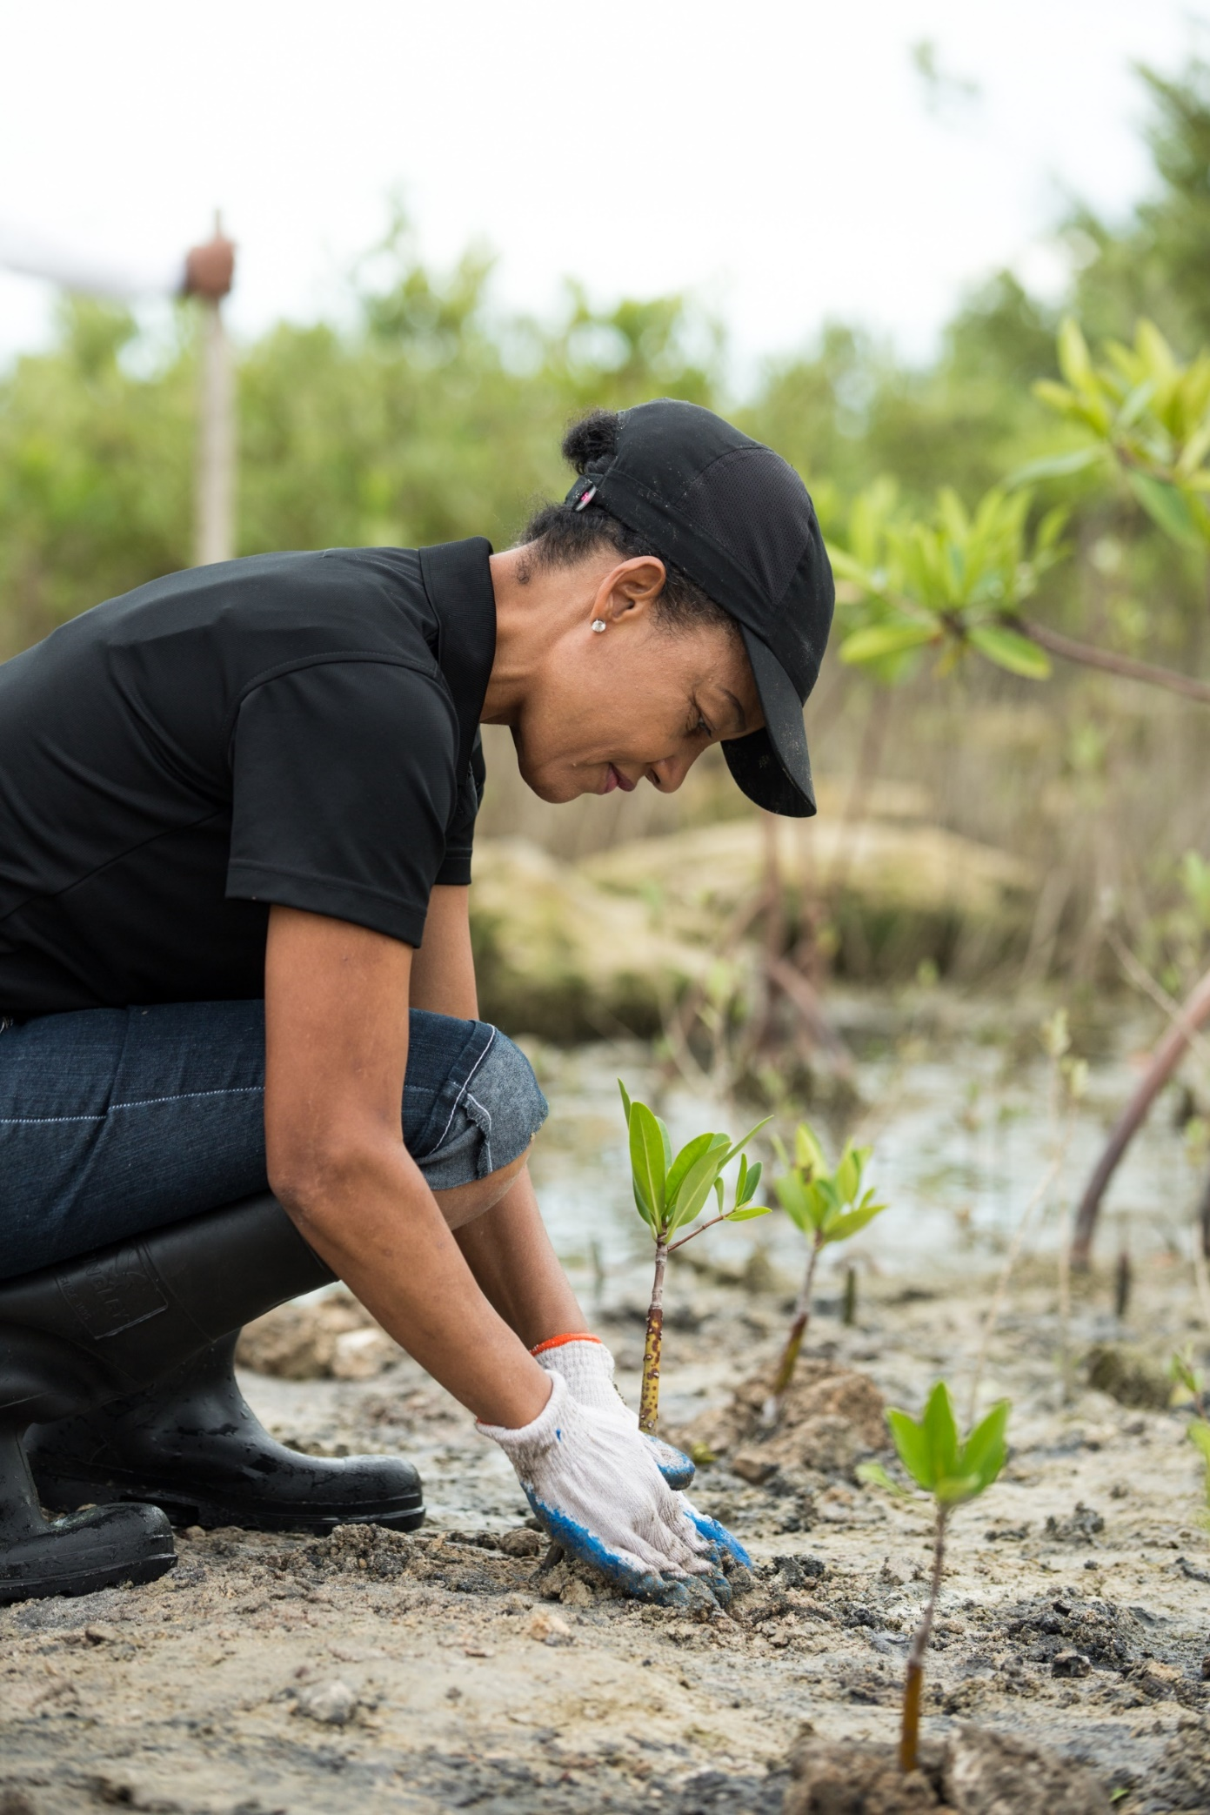


  Rotary Community Group Collaboration
Notes:
The Pilot Establishment Team have been conducting some workshops with District teams in recent weeks and these are some of the larger scale, more impactful possibilities they imagined:
Upscaled tree planting or recycling initiatives in partnership with local government
Projects on a 100km walkway connecting several small communities e.g. seating, disability access, photo spots, native planting sites, etc. featuring Rotary signage
Mobile clinics for people who find it difficult to access services in partnership with relevant agencies
Billboards on freeways/motorways – “Rotary, there when you need us", with an image of Rotarians supporting local people affected by floods/fire/earthquake

Slide 9
  Rotary Community Groups (RCGs) and Leaders (RCLs) timeline
Today
109 days
100%
20 days
100%
Club Presidents discuss with their members how they would like to be grouped
District leaders and Regionalisation team review survey results together and prepare draft groupings
With initial support from District leaders, RCGs meet to determine how they will work together
699 days
0%
92 days
0%
365 days
0%
Sep 2023
426 days
Sep 2023
Oct 2023
Nov 2023
Dec 2023
Jan 2024
0%
120 days
0%
365 days
0%
122 days
Club Presidents and Secretaries complete survey to specify the primary and secondary way they would prefer to be grouped with other clubs
RCGs finalised, accommodating club preferences as much as possible
Nominations for RCLs called and elections held
0%
91 days
0%
912 days
0%
912 days
0%
212 days
0%
Notes:
The timeline for identifying Rotary Community Groups and Community Leaders is:
In September, Rotary and Rotaract clubs will be provided a survey to indicate how they would like to be grouped together for future collaboration on activities and projects.
District leaders and the Regionalisation team will review the survey results together and work on the groupings, in liaison with the clubs where needed.
The new Community Groups are expected to be advised to clubs by November.
RCGs will then meet to determine how they will collaborate together and how the RCL role will work for their group
Club members will then be invited to express interest in nominating for a Rotary Community Leader role in their Community Group. This is likely to be in January.
Community Leaders will then be elected by March 2024 to enable them to participate in a learning program in preparation for their new role to commence in July 2024.

Slide 10
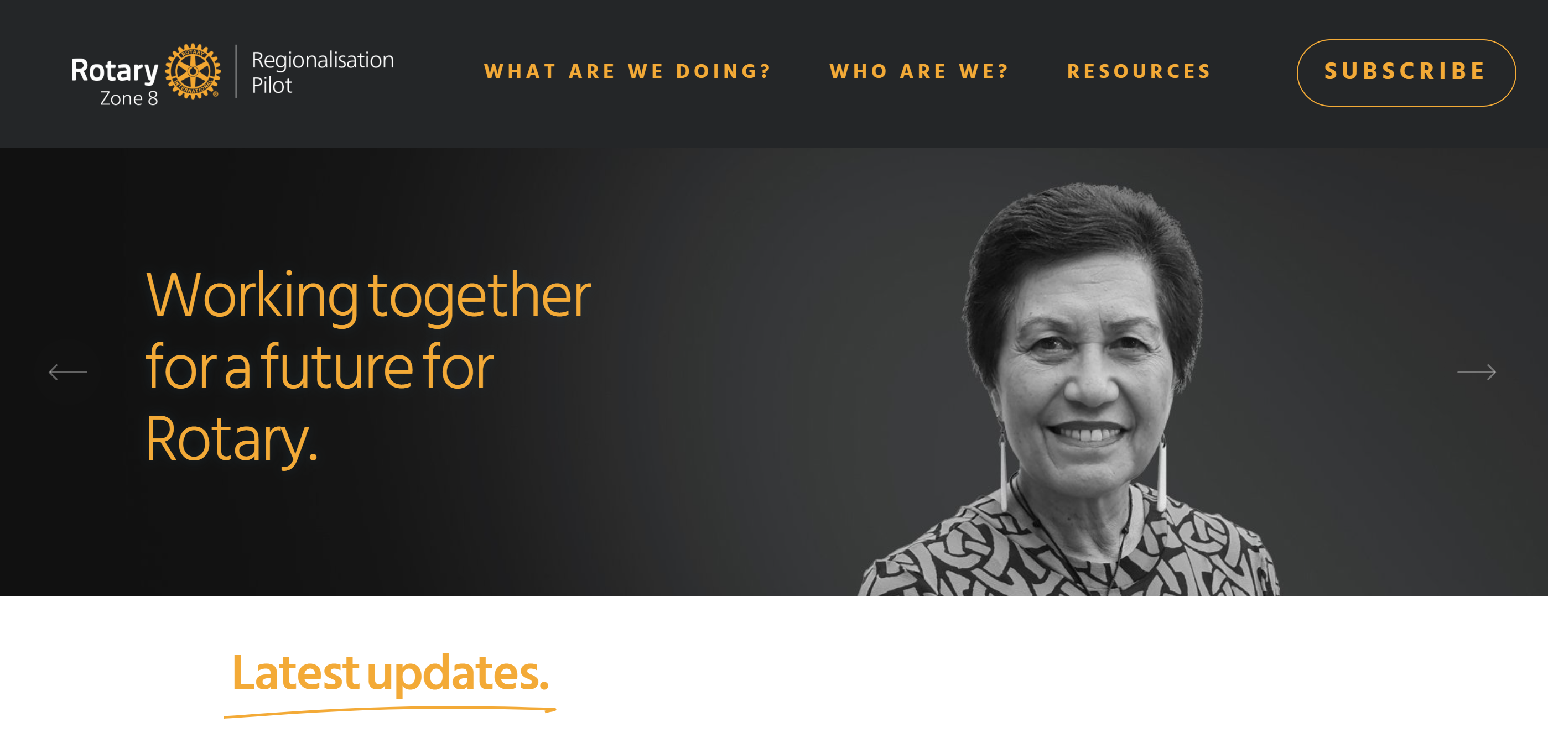
  For more information
      The Creating Tomorrow website is being updated regularly. For more information on the latest progress of the Regionalisation Pilot, visit CreatingTomorrowRotary.org
Notes:
The Creating Tomorrow website is your primary source of information for the Regionalisation Pilot. It is now being updated regularly with the latest news on the Pilot’s progress.
If you have any questions, you can email the Regionalisation Pilot Team directly at RotaryRegionalPilot@gmail.com.
If you have a specific question about elections, email Zone8Elections@rotary.org.
Your district will have one or many regionalisation champions. Please reach out to them for information.
You can stay informed by attending the regular webinars and reviewing the regular email updates.

