Slide 1


  Zone 8
  Regionalisation
  Pilot
Update for clubs and members,
September 2023
  Jyoti, Rotarian since 2016.

Slide 2
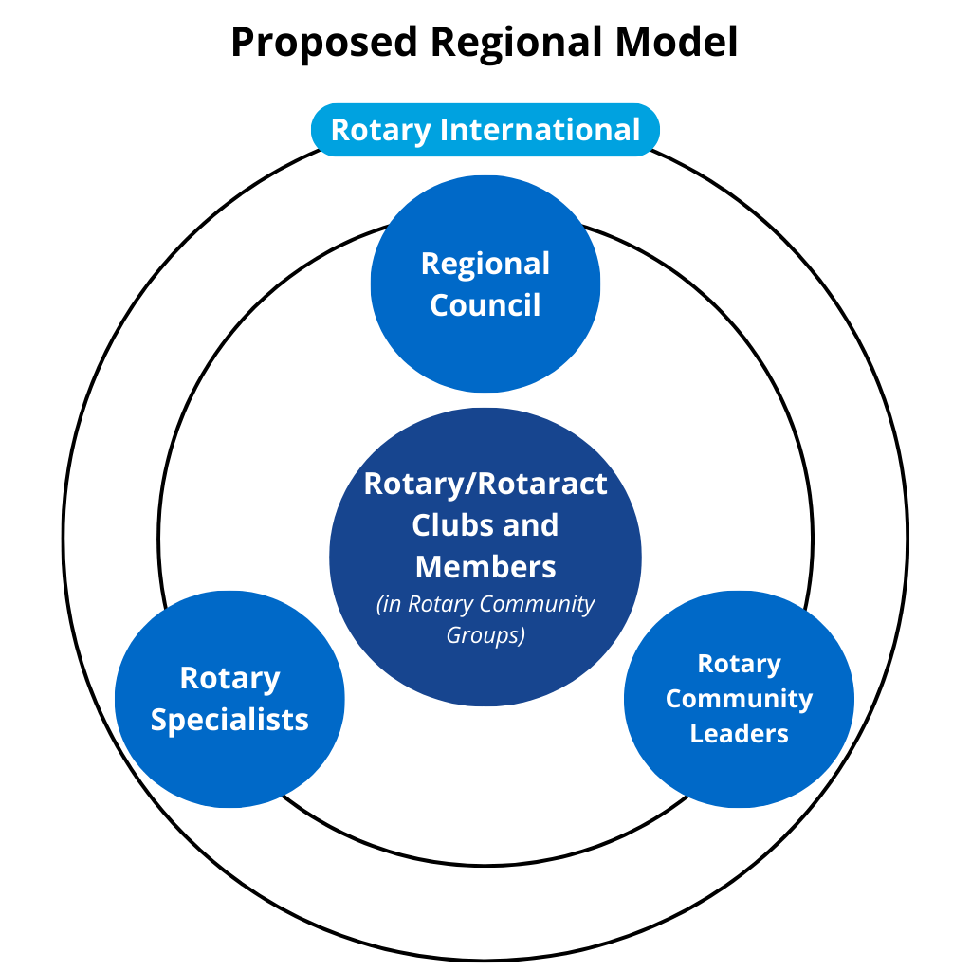
  Pilot operating model

Slide 3
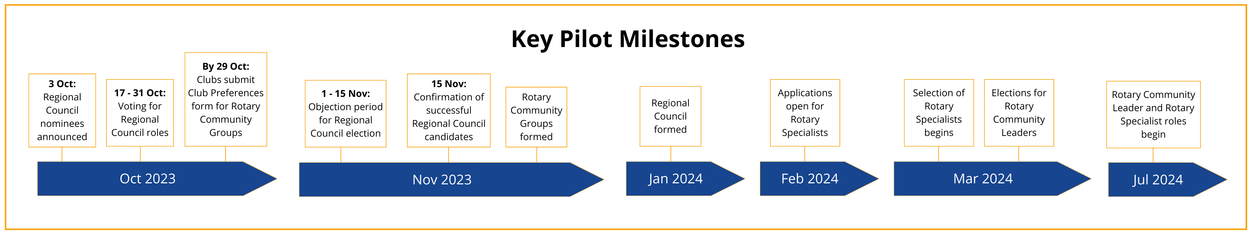
  Upcoming Pilot milestones

Slide 4
  Regional Council structure
Rotary International (and The Rotary Foundation)
*Portfolios:
Service Projects and Programs
Public Image and Partnerships
Membership
Learning and Development
Fundraising and Grants
Diversity, Equity and Inclusion
Regional Council Chair
Chair-Elect
Portfolio Leads*
Rotaract Nominee
Rotary Communities Nominee
Corporate and Admin (non-elected)
Multi-national Advisory Committee
Functional Committees (Legal Entities, Financial Assets, Insurance, etc.)
Rotary Community Leaders
Portfolio Committees*
Rotary Specialist Network
Liaison for Incorporated Entities
Country Representatives
District Governors
RI Office (Sydney)
Zone Strategic Planning
Club leaders and members requiring support go to…

Slide 5
  Regional Council election timeline
Today
109 days
100%
20 days
100%
1 – 15 Nov:
If no objections are received, results will be upheld and confirmed on 15 Nov
17 – 31 Oct:
Clubs submit preferential votes electronically via link emailed to Club Presidents
699 days
0%
92 days
0%
365 days
0%
Nominees
426 days
Voting
Results
Objection Period
Regional Council
0%
120 days
0%
365 days
0%
122 days
3 Oct:
Nominees listed on Creating Tomorrow website, and
voting instructions emailed to Club Presidents and Secretaries
0%
91 days
1 Nov:
Results of vote are announced
Jan 2024:
Regional Council commences
0%
912 days
0%
912 days
0%
212 days
NOTE: Please ensure your Club President’s email address is correct in My Rotary so they receive the ballot. If your Club President cannot vote during the voting period, they will need to select another Club Officer to vote.
0%

Slide 6


  What are Rotary Community Groups (RCGs)?
      A new way of grouping clubs based on commonalities such as:
      RCGs can meet in person, online or a combination of both, and choose how often they meet
      Clubs can also nominate a secondary grouping that will operate in online networks across the Zone e.g. environment, youth, DEI, etc.
          Geography
          E.g. clubs may be close together or spread out
          Type of club
          E.g. online clubs, passport clubs, corporate clubs
          Common feature
          E.g. shared language, specific cause

Slide 7
  Rotary Community Groups: Club Preferences Form
      Clubs will tell us how they want to be grouped via the Club Preferences form emailed to Club Presidents and Secretaries on 20 September
      Each club’s President or Secretary will complete one Club Preferences form on behalf of their club by 29 October 2023 11:59pm AEDT
      The responses in the form need to reflect the majority view of club members
      It is expected that clubs will discuss/workshop the questions in the form together
      In November, we will work with District leaders to determine the best groupings for that District, accommodating club preferences as much as possible

Slide 8
  Rotary Community Leaders (RCLs)
      Once RCGs are formed, they will meet to discuss:
                their vision
                what leadership and support they will need
                how and when they will meet
      The outcomes of this discussion will be documented and circulated to all members, and will supplement the position description for their RCL
      Once this is complete, nominations for RCLs will open
      Each club in an RCG will submit one preferential vote to elect their RCL

Slide 9
  What is a Rotary Specialist?
      Individuals or teams of people who are experts in a particular field and:
                Will give advice and/or support to clubs
                Know who other experts are
                Will liaise with clubs remotely and/or in person
      They can be:
                People who have been in Rotary anywhere from a few months to a few decades
                People who have never held a role outside their club before
                Rotaractors
                Current or former Assistant or Area Governors
                People who are currently or have previously been on a District Board or Committee
      Applications to be a Rotary Specialist will open in February 2024

Slide 10






  Examples of Rotary Specialists
I’m a club compliance nerd!
I’m an experienced event manager.
Helping clubs resolve conflict is my superpower!
Due to my experience as a District Membership Chair, I’m an expert in helping clubs recruit new members.
I help organise RYLA in my District and love helping clubs get involved for the first time.
I have a marketing background and want to help clubs with their Public Image.

Slide 11




  Examples of Rotary Specialists
Alex has built a multinational export company over the last 20 years.
Qualifications: MBA, Master of Leadership, Past District Governor
Specialist Area: Leadership development
Skills: Pathways to leadership, Rotary leadership options, RI Learning Centre
Robin has extensive experience as a lawyer, mediator and arbitrator. She has delivered training in conflict management at a District and club level.
Qualifications: Master of Law, LLM, Master of Dispute Resolution
Specialist Areas: Conflict training, coaching and resolution
Skills: Conflict resolution, constitution and bylaws framing, board governance
Chris is an event manager with 10 years’ experience organising corporate events
Qualifications: N/A
Specialist Areas: Event management, District and club changeovers, District conferences
Skills: Venue management, menu allocations, seating arrangements, speaker arrangements
Robby has been a Rotarian for 15 years and a vocational educator for 25 years.
Qualifications: Vocational learning diplomas, Past President, AG of 3 years
Specialist Areas: Learning and development, leadership pathways
Skills: RI Learning Centre, RLI facilitation, District Assembly coordination, learning facilitation, L&D documentation/presentations

Slide 12
  Membership Update
      A Zone-wide New Club Development Team is now in place to help start up new clubs. The list of New Club Development Specialists is available on the Creating Tomorrow website. You can contact them for assistance developing both “traditional” and “new style” clubs.
      We will soon be establishing a Zone-wide Club Culture Transformation Team to help RCGs and RCLs assist existing clubs to retain and attract members.
      In October, a survey will be distributed to District Membership Chairs and Assistant Rotary Coordinators to identify gaps in membership training materials. A Zone-wide Membership Training Manual will then be developed to address these gaps.

Slide 13

  Transformation of District Duties and Functions
      Starting in early 2024, certain duties and functions currently carried out by Districts and District leaders will gradually be transferred to the Regional Council
      Consultation with the Governor group is being used to develop a clear plan
      Certain duties and functions related to Membership and Public Image will move to the Regional Council first, as key areas where the Pilot’s operating model can help Zone 8 achieve its goals
      Districts and District Governors will remain in place and will work with key actors in the Pilot’s operating model to support clubs
      Primary responsibility for supporting clubs will shift from Districts to Rotary Community Leaders
      Current club and District arrangements regarding The Rotary Foundation will remain in place
“I would like to think that the pioneering days of Rotary have only just begun. What’s 40 years in the life of a great movement? There are just as many new things to be done as there ever were.”
Paul Harris,
The Rotarian,
February 1945

Slide 14
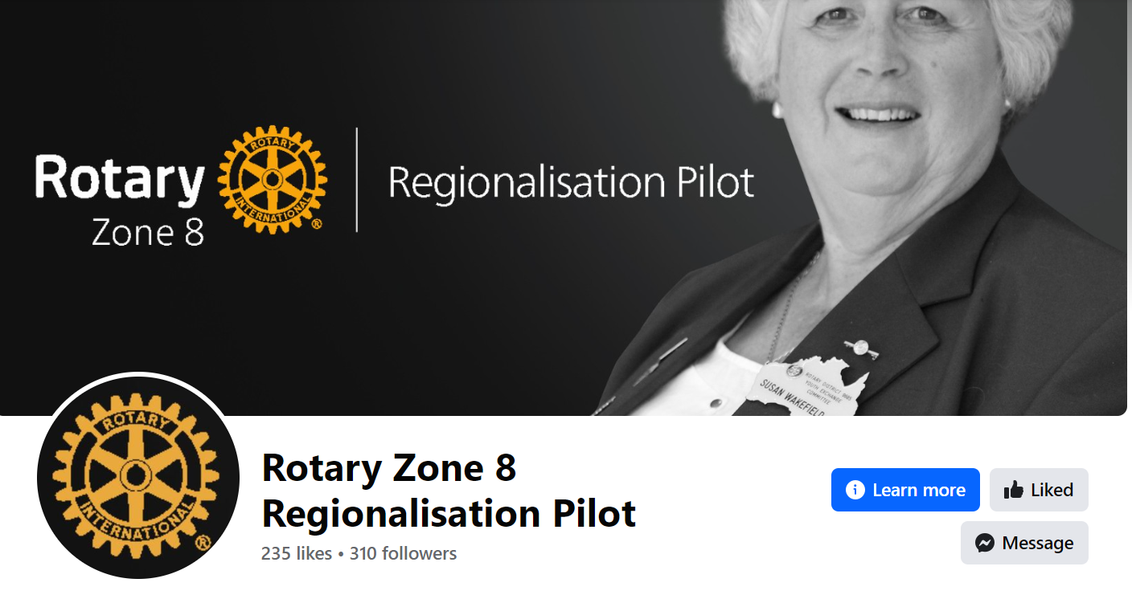
  For more information
      For more information on the latest progress of the Regionalisation Pilot, visit CreatingTomorrowRotary.org, and follow our new Facebook page.

