Slide 1
Your next role in Rotary awaits!
Portfolio Committee Member and Rotary Specialist Roles,
February 24
Jyoti, Rotarian since 2016.

Slide 2
Coming up…
What is a Regional Council Portfolio Committee Member?
The seven different Portfolio Committees you can join
What is a Rotary Specialist?
The Rotary Specialist Database
How are these roles different from each other?
A new network of support for clubs
Other Pilot roles you may want to apply for
Questions

Slide 3
What is a Portfolio Committee Member?
Works with a specific Portfolio Lead and their fellow Committee Members to:
Help develop Zone-wide strategies, initiatives and best practices
Help their Portfolio achieve their goals throughout the Zone
You can be appointed as a Member of more than one Portfolio.

Slide 4
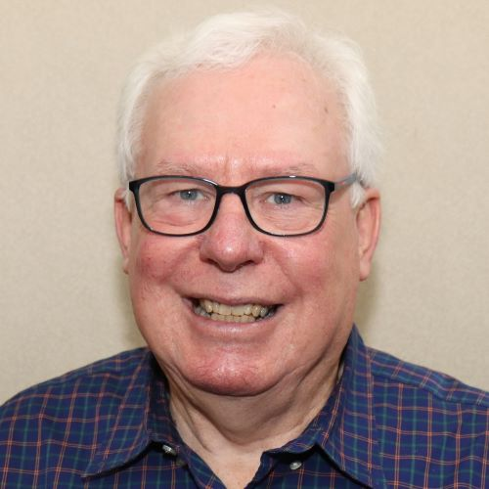
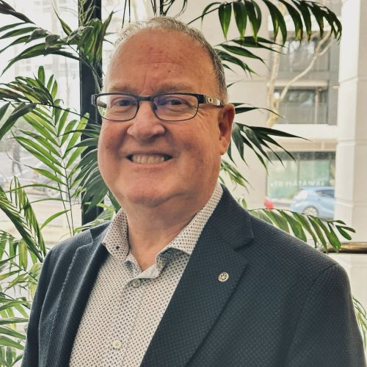
Your Regional Council
Chair
Dallas Booth AM
RC of Turramurra
NSW, Australia
Chair-Elect
Tony Heyward
RC of Tawa
New Zealand

Slide 5
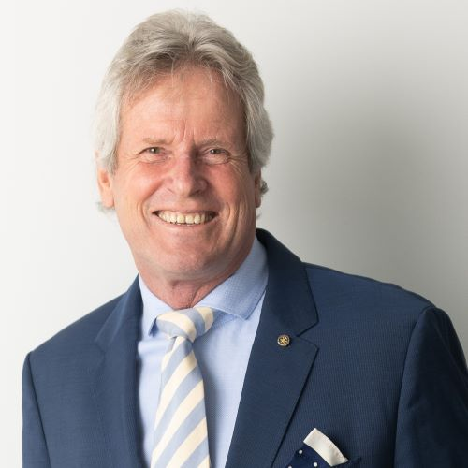
Public Image and Partnerships
Looking for expertise in…
Marketing
Government relations
Corporate partnerships
Brand and reputation management
Portfolio Lead
Neil McWhannell
RC of Wahroonga
NSW, Australia

Slide 6
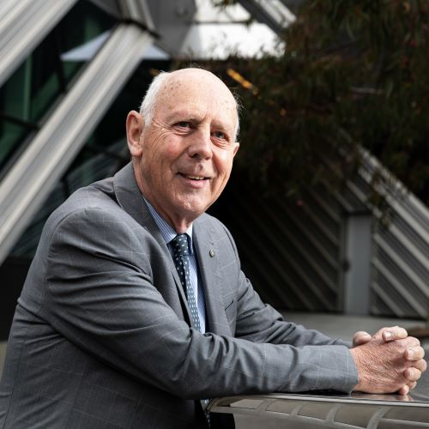
Major Fundraising and Grants
Looking for expertise in…
Grant management
Grant maximisation
Corporate and government fundraising
Club fundraising
Portfolio Lead
Dr Peter Rogers AM
RC of Melbourne
Melbourne, Australia
Fellowships and scholarships

Slide 7
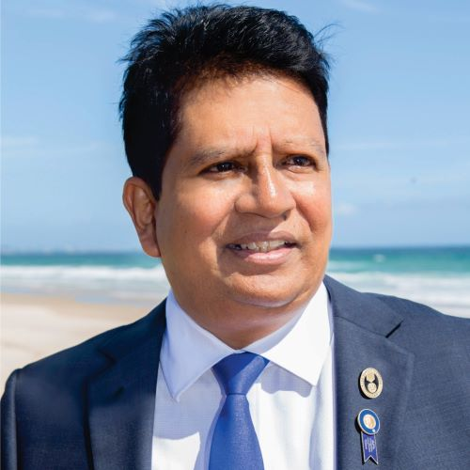
Membership
Looking for expertise in…
Starting up new clubs
Transforming existing clubs
Membership best practices
Alumni engagement
Portfolio Lead
Andy Rajapakse
RC of Burleigh Heads
Queensland, Australia

Slide 8
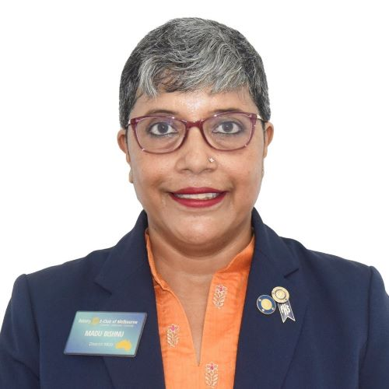
Service Projects and Programs
Looking for expertise in…
Community projects
Youth programs
Country-based projects
Vocational award schemes
Portfolio Lead
Madhumita Bishnu
E-Club of Melbourne
Melbourne, Australia

Slide 9
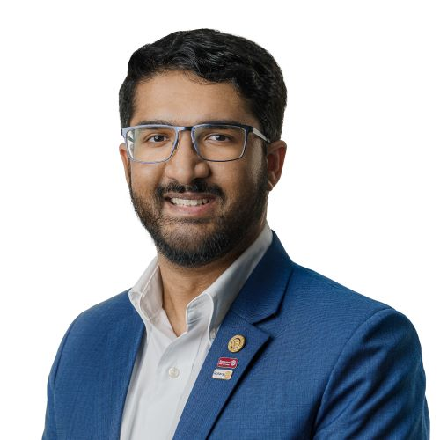
Rotaract
Looking for…
Island Nations/Rotaract Oceania MDIO Representative
Portfolio Lead
Eeshwar Rajagopalan
Rotaract Club of Subiaco /
RC of Elizabeth Quay
Western Australia, Australia
Note: Rotaractors on other Portfolio Committees will be approached by the Rotaract Portfolio to act as a liaison between the two Portfolio Committees.

Slide 10
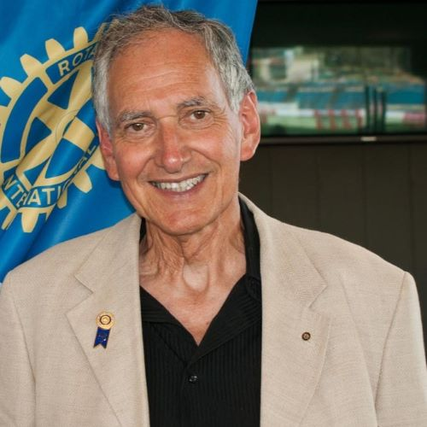
Learning and Development
Looking for expertise in…
Leadership strategy
Learning and development (Zone and club level)
Events
Portfolio Lead
Euan Miller
RC of Norwood
South Australia, Australia

Slide 11
Diversity, Equity and Inclusion (DEI)
Looking for expertise in…
DEI analysis
DEI promotion and support
Portfolio Lead
To be advised

Slide 12
What is a Rotary Specialist?
A Specialist can be:
Someone who has been in Rotary anywhere from a few months or a few decades
Rotaractors
Someone who has held multiple leadership positions in Rotary, or none at all
Someone who is already or has not yet delivered assistance to clubs and members in their area of expertise
Someone who has relevant formal qualifications or has gained expertise through practical experience
An expert in a particular field who:
Gives advice and/or support to clubs
Knows who other experts are
Liaises with clubs throughout the Zone online or in person
You can be a Specialist in more than one field.

Slide 13
What experience can a Specialist have?
Formal educational and professional qualifications
Professional/career experience
Volunteering experience
(within or outside of Rotary)
Other types of informal practical experience

Slide 14
Examples of Rotary Specialists
Helping clubs resolve conflict is my superpower!
I’m a club compliance nerd!
I know how to run great events!
As an experienced District Membership Chair, I’m an expert in helping clubs recruit new members.
Marketing expert here – ready to help clubs promote themselves!
I organise RYLA in my District and love helping clubs get involved.

Slide 15
What is the Rotary Specialist Database?
All Specialists will be included in an online database clubs and members can use to easily find people who are experts in a field they need assistance with.
That’s why you should consider being a Specialist even if you’re already helping clubs in your area of expertise.
Being in the Specialist database will allow clubs to find you more easily!
You’ll also be able to find other experts in your area of specialty who you can collaborate with.

Slide 16
What’s the difference?
Portfolio Committee Member
Rotary Specialist
Rotary Community Leader
Big picture strategist.
Develops Zone-wide strategies with their Committee team.
Does not assist clubs directly with day-to-day operations.
Subject matter expert.
Works directly with clubs across the Zone to provide guidance in their specific area of expertise.
Facilitator, connector, coach.
Helps the clubs in their Rotary Community Group to thrive and grow.
An individual can hold all three roles at once.

Slide 17
Club support network
Zone 8 Rotary and Rotaract clubs
Grouped into Rotary Community Groups (RCGs)
*Responsibilities related to The Rotary Foundation will remain with District teams
Portfolio Committees
Rotary Specialists
Each RCG supported by a Rotary Community Leader (RCL)
District Teams*
(Agreed responsibilities will transfer to relevant Portfolio Committees)
Rotary International Sydney Office
Committees
E.g. Multi-National Advisory Committee, Zone Insurance and Protection Committee
Portfolio Leads
Rotaract Director
RCL Nominee
District Governors
Regional Council
Rotary International
The Rotary Foundation

Slide 18
Other Pilot roles
Applications opening soon:
Currently being selected:
Country Representatives on Multi-National Advisory Committee
IT Lead
(member of Corporate and Administration team)
Treasurer
Members of additional committees on the Regional Council
Rotary Community Leaders
Corporate and Administration Lead
Rotary Community Leader Nominee
DEI Portfolio Lead

Slide 19
Timeline
2 – 29 February:
Applications open for Specialist and Portfolio Committee Member roles
2
29 February 5pm AEDT:
Applications close
3
February – March 2024:
Interviews with Committee Member applicants are held, Portfolio Leads select their teams
1
March 2024:
Specialist applications are vetted
April 2024:
Specialist applicants receive email confirming if they have been appointed
1 July 2024:
Rotary Specialists begin supporting clubs and Specialist Database opens
4
5
6

Slide 20
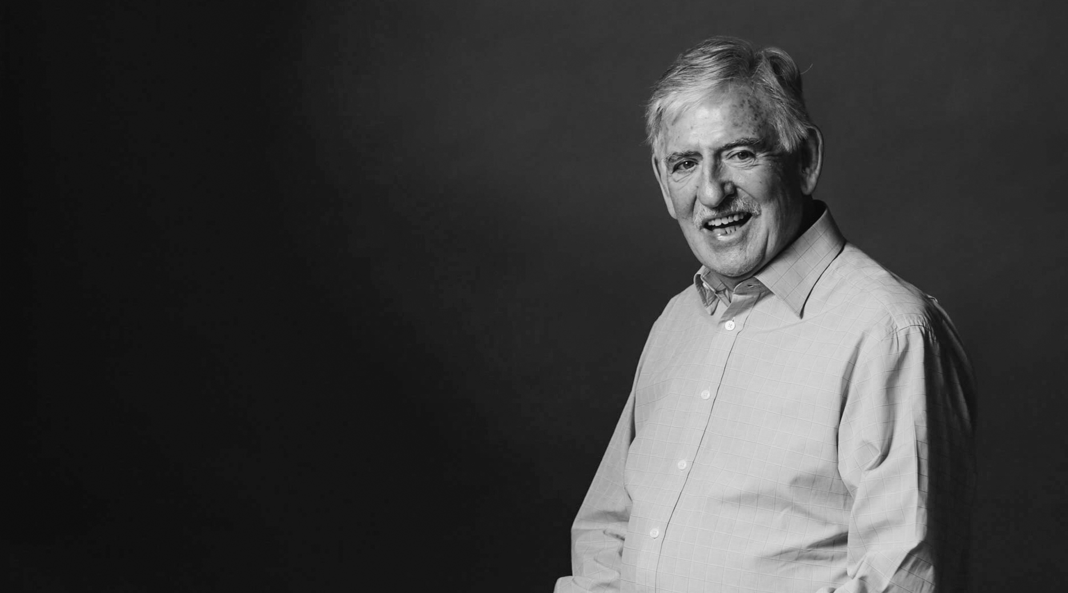
Learn more
CreatingTomorrowRotary.org
RotaryRegionalPilot@gmail.com
Follow the Pilot on Facebook

